Slide 1

Name: Rama Krishna Kamma
CWID: 50321021
Project: Map-Reduce for Distributed Data Processing in Big Data
Analysis for Genome Sequence

Slide 2
Why Map Reduce?
Here are the some problems in Traditional Approach is
Large Concurrent Systems
Grid Computing
Rolling Your Own Solution
How do you scale to more machines?
How do you handle machine failures?
How do you facilitate communication between nodes?

Slide 3
What is MapReduce?
MapReduce is a programming paradigm that enables massive scalability across hundreds or thousands of servers in a Hadoop cluster.
As the processing component, MapReduce is the heart of Apache Hadoop.
It has two distinct tasks
Mapper Phase
Reducer Phase

Slide 4
How MapReduce Works?
The Map function takes input from the disk as <key,value> pairs, processes them, and produces another set of intermediate <key,value> pairs as output.
The Reduce function also takes inputs as <key,value> pairs, and produces <key,value> pairs as output.
map (k1,v1) → list(k2,v2)
reduce (k2,list(v2)) → list(v2)

Slide 5
Components of MapReduce
Mapper:
The input data is first split into smaller blocks. Each block is then assigned to a mapper for processing.
For example, if a file has 100 records to be processed, 100 mappers can run together to process one record each.
The Hadoop framework decides how many mappers to use, based on the size of the data to be processed and the memory block available on each mapper server.
Reducer:
After all the mappers complete processing, the framework shuffles and sorts the results before passing them on to the reducers. A reducer cannot start while a mapper is still in progress.
All the map output values that have the same key are assigned to a single reducer, which then aggregates the values for that key.

Slide 6
Components of MapReduce ..
Combiner:
Combine is an optional process. The combiner is a reducer that runs individually on each mapper server. It reduces the data on each mapper further to a simplified form before passing it downstream.
This makes shuffling and sorting easier as there is less data to work with.
Partition:
Partition is the process that translates the <key, value> pairs resulting from mappers to another set of <key, value> pairs to feed into the reducer.
It decides how the data has to be presented to the reducer and also assigns it to a particular reducer.

Slide 7
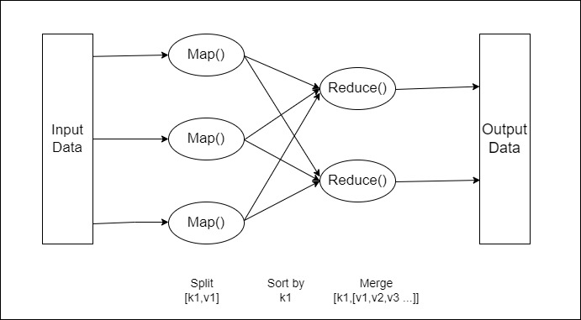
MapReduce Job Execution Flow

Slide 8
Advantages of MapReduce:
Scalability: Businesses can process petabytes of data stored in the Hadoop Distributed File System (HDFS).
Flexibility: It enables easier access to multiple sources of data and multiple types of data.
Speed: With parallel processing and minimal data movement, it offers fast processing of massive amounts of data.
Simple: Developers can write code in a choice of languages, including Java, C++ and Python.

Slide 9
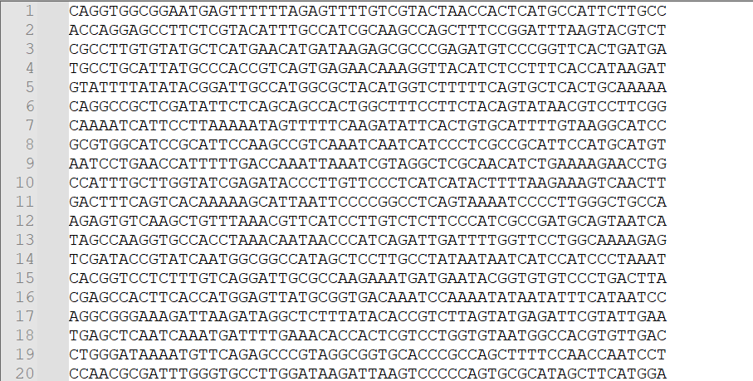
MapReduce in Genome Sequence:
Read mapping and variant calling are often the first steps in genome sequencing analysis.
Even with multithreading on a multi-core processor, this computing phase takes a long time, especially for whole genome sequencing.

Slide 10
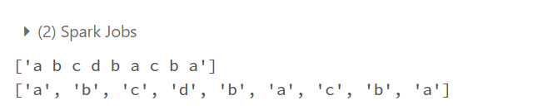
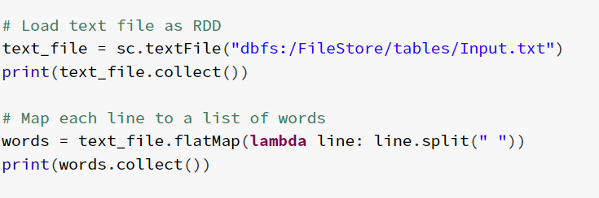
Execution Flow:
Reading the File: Here in this step, we are reading file and convert into list.
Output:

Slide 11
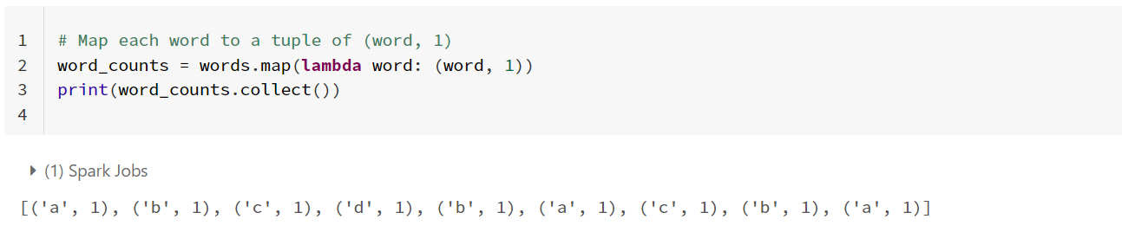
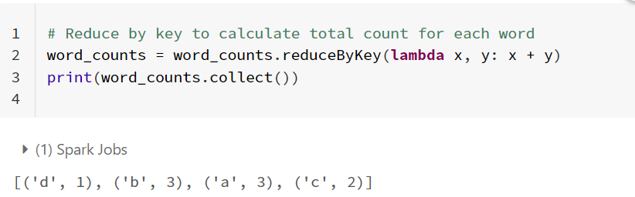
Execution Flow ..
Mapper: After Mapper phase each word counted and represented in word to a tuple of (word, 1).
Reducer: After Reducer phase key to calculate total count for each word.

Slide 12
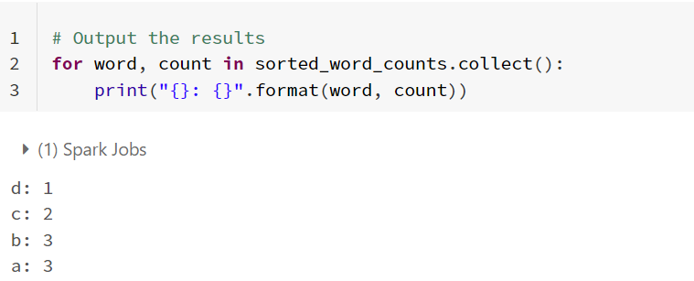
Execution Flow ..
Output: After sorting(optional) word counts from the collection and displaying the final output which is in the form of key, value pair.

Slide 13
Conclusion:
This paper examines the effective implementation of MapReduce programming model for genome sequencing offers advantages such as handling big data, scalable processing, fault tolerance, and ease of programming.
MapReduce frameworks like Apache Hadoop and Apache Spark provide robust tools for genomic analysis. However, challenges such as data preprocessing, algorithm optimization, and data privacy concerns remain.
Further research and development are needed to fully realize the potential of MapReduce in genome sequencing, which has the potential to accelerate research in genetics, genomics, and personalized medicine.

Slide 14
References:
Mingyue Luo,Gang Liu, “Distributed log information Processing with Map-Reduce,” 2010 IEEE International Conference on Information Theory and Information Security DOI: 10.1109/ICITIS17077.2010, 17- 19 Dec. 2010.
CK Fong,“A Study in Deploying Self-Organized Map(SOM) in an Open Source J2EE Cluster and Caching System, ” 2007 IEEE/ICME International Conference on Complex Medical Engineering, pp.778- 781,2007.
Gul Shaira Banu Jahangeer, T. Diliphan Rajkumar, “An Implementation of Map Reduce on the Hadoop for Analyzing Big Data,” International Journal of Recent Technology and Engineering (IJRTE) ISSN: 2277- 3878, Volume-8 Issue-4S2, December 2019.
S Papadimitriou, “DisCo: Distributed Co-clustering with MapReduce. A Case Study Towards Petabyte-Scale End-to-End Mining, ” Data Mining,ICDM ’08. Eighth IEEE International Conference on, pp. 512 - 521,2008.
https://hadoop.apache.org/docs/r1.2.1/hdfs design.html

Slide 15
Thank you

